Slide 1
Lesson 23 – Hibernate. Spring Data

Slide 2
Lesson goals
Hibernate ORM
SessionFactory vs EntityManager
Fetch Types (Eager vs lazy)
Fetch Modes (select vs join vs subselect)
N+1 problem
Spring Data overview

Slide 3
Hibernate

Slide 4
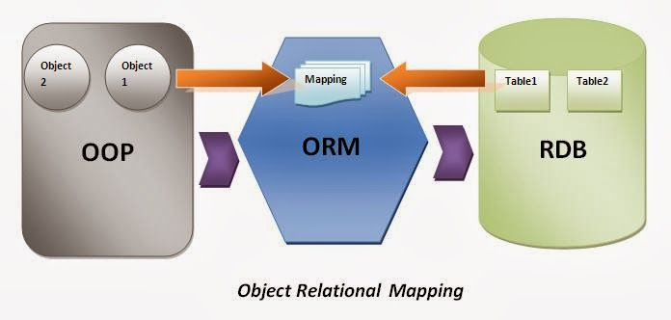
Object-relational mapping

Slide 5
Hibernate
Hibernate ORM is an object-relational mapping tool.
GNU Lesser General Public License 2.1.
Primary feature is mapping from Java classes to database tables, and mapping from Java data types to SQL data types

Slide 6
Java Persistence API
Interface specification that describes the management of relational data in applications using Java Platform.
Persistence in this context covers three areas:
API defined in the javax.persistence package
Java Persistence Query Language (JPQL)
object/relational metadata
Reference implementation for JPA is EclipseLink.

Slide 7
Hibernate entity example
implementation "org.hibernate:hibernate-core:5.4.30.Final"
@Entity @Table(name = "students") public class Student { @Id @GeneratedValue(strategy = GenerationType.AUTO) private Integer id; @Column(name = "name", nullable = false, length = 32) private String name;
@OneToMany private List<Grade> grades;
}

Slide 8
Hibernate entity lifecycle
Transient
Managed
Detached
Deleted

Slide 9
Hibernate. Ignore field
@Entity @Table(name = “students") public class Student { // .. fields are emited
@Transient private String rawPassword;
}

Slide 10
Hibernate. SessionFactory
@Bean public LocalSessionFactoryBean sessionFactory(DataSource dataSource) { LocalSessionFactoryBean sessionFactory = new LocalSessionFactoryBean(); sessionFactory.setDataSource(dataSource); sessionFactory.setPackagesToScan("org.geekhub.studentregistry"); sessionFactory.setHibernateProperties(hibernateProperties()); return sessionFactory; } private Properties hibernateProperties() { Properties props = new Properties(); props.setProperty("hibernate.hbm2ddl.auto", "create-drop"); props.setProperty("hibernate.dialect", "org.hibernate.dialect.PostgreSQLDialect"); return props; }

Slide 11
Hibernate. SessionFactory
Session currentSession = sessionFactory.getCurrentSession(); Student student = currentSession.get(Student.class, 10);

Slide 12
Hibernate. EntityManager
Prefer EntityManagerFactory and EntityManager
@Bean public LocalContainerEntityManagerFactoryBean entityManagerFactoryBean(DataSource dataSource) { var factoryBean = new LocalContainerEntityManagerFactoryBean(); factoryBean.setDataSource(dataSource); factoryBean.setPersistenceProviderClass(HibernatePersistenceProvider.class); factoryBean.setPackagesToScan("org.geekhub.studentregistry"); factoryBean.setJpaProperties(hibernateProperties()); return factoryBean; } private Properties hibernateProperties() { Properties props = new Properties(); props.setProperty("hibernate.hbm2ddl.auto", "create-drop"); props.setProperty("hibernate.dialect", "org.hibernate.dialect.PostgreSQLDialect"); return props; }

Slide 13
Hibernate. EntityManager
@PersistenceContext private EntityManager entityManager; public Student getStudent(int id) { return entityManager.find(Student.class, id); }

Slide 14
Fetch Types
Defines strategies for fetching data from the database.
EAGER (immediate, together with root object)
LAZY (later, when used or never)

Slide 15
Fetch Modes
Fetch options on associations. Defines more of the "how" of fetching, whereas JPA Fetch Type focuses on the "when".
SELECT (default strategy for LAZY relations)
JOIN (default strategy for EAGER)
SUBSELECT - uses a sub-select query to load the additional collections

Slide 16
N+1 problem
Let's say you have a collection of Student objects (database rows), and each Student has a collection of Grade objects (also rows). In other words, Student -> Grade is a 1-to-many relationship.
Now, let's say you need to iterate through all the students, and for each one, print out a list of the grades. The naive implementation would do the following: SELECT * FROM Student;
And then for each Student: SELECT * FROM Grade WHERE StudentId = ?
In other words, you have one select for the Students, and then N additional selects, where N is the total number of students.
Alternatively, one could get all grades and perform the lookups in memory: SELECT * FROM Grade
This reduces the number of round-trips to the database from N+1 to 2. Most ORM tools give you several ways to prevent N+1 selects.

Slide 17
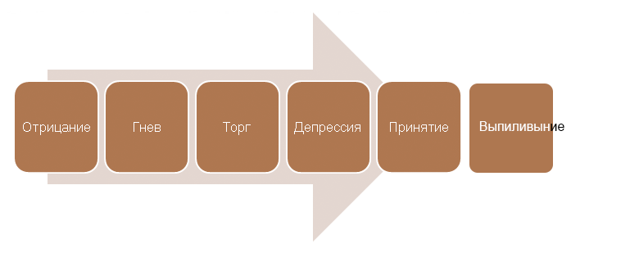
Hibernate…

Slide 18
Spring Data - No More DAO Implementations

Slide 19
Spring Data - No More DAO Implementations
implementation "org.springframework.data:spring-data-jpa:2.4.7"
An implementation of the repository abstraction that's a key building block of Domain-Driven Design based on the Java application framework Spring. Transparently supports all available JPA implementations and supports CRUD operations as well as the convenient execution of database queries.

Slide 20
Spring Data JPA. Built-in API
public interface StudentRepository extends JpaRepository<Student, Long> { // NOTHING
}
public interface JpaRepository<T, ID> extends … { List<T> findAll(); List<T> findAll(Sort sort); List<T> findAllById(Iterable<ID> ids); <S extends T> List<S> saveAll(Iterable<S> entities); void deleteInBatch(Iterable<T> entities); void deleteAllInBatch(); T getOne(ID id); // ... }

Slide 21
Spring Data JPA. Configuration
@EnableJpaRepositories(basePackages = "org.geekhub.studentregistry.data") public class PersistenceConfig { }
public class Student { @Id private Integer id; private String name; // ... }

Slide 22
Spring Data JPA - Custom API
@Repository
public interface StudentRepository extends JpaRepository<Student, Long> { Student findByName(String name); }

Slide 23
Spring Data JPA - Custom query
@Repository
public interface GradeRepository extends JpaRepository<Grade, Long> { @Query("SELECT g FROM Grade g WHERE g.type = :grageType") List<Grade> findByGradeType(@Param("grageType") GradeType grageType); }
@Repository
public interface StudentRepository extends JpaRepository<Student, Long> { @Modifying @Query("update Student s set s.status = 'DISABLED' where s.email = :email") int disableStudentByEmail(@Param("email") String email); }

Slide 24
Spring Data JDBC (lite JPA)
No caching
No lazy-loading
No sessions
No dirty-tracking
No schema-generation

Slide 25
Spring Data JDBC. Configuration
implementation "org.springframework.data:spring-data-jdbc:2.1.7"
public class Student { @Id private Integer id; private String name; // ... }

Slide 26
Spring Data JDBC. Usage
@Repository public interface StudentRepository extends CrudRepository<Student, Long> { }
public interface CrudRepository<T, ID> extends Repository<T, ID> { <S extends T> S save(S entity); Optional<T> findById(ID id); Iterable<T> findAll(); void deleteById(ID id); void delete(T entity); // ... }

Slide 27
Useful links
Hibernate
Spring Data JPA
Spring Data Jdbc

Slide 28
Homework
Eliminate boilerplate DAO’s using any of learned frameworks
Spring Data JPA or Spring Data JDBC
Hibernate
Cover database layer by tests

Slide 29
Thanks!
Any Questions?
Or find us in Slack:
@Yaroslav Brahinets
@Vasya Rudas

